Slide 1
EDA Graded Assessment
DoSelect

Slide 2
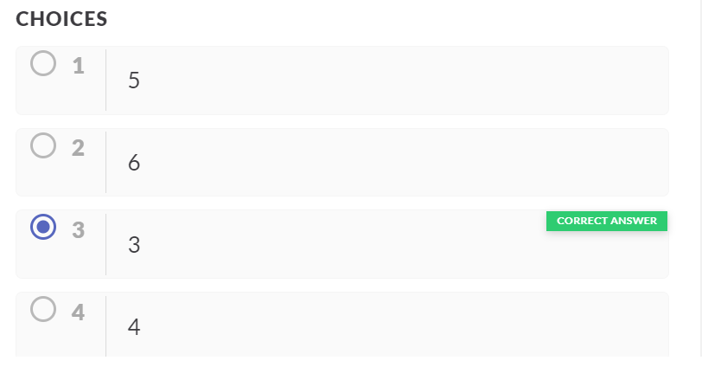
EDA Question 1
DESCRIPTION
Find how many categorical variables are there in the data.

Slide 3
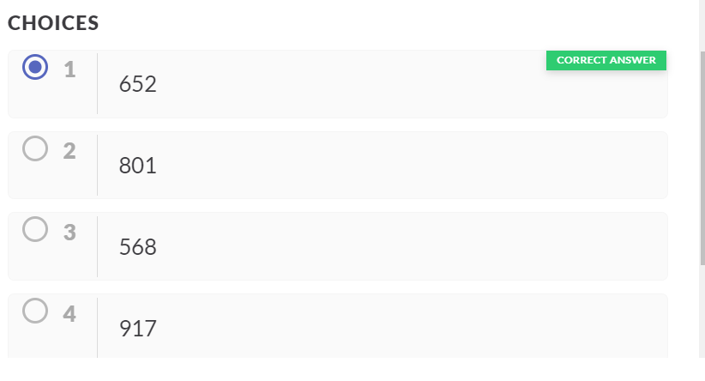
EDA Question 2
DESCRIPTION
Check the data values in Population variable and state the count of '#'.

Slide 4
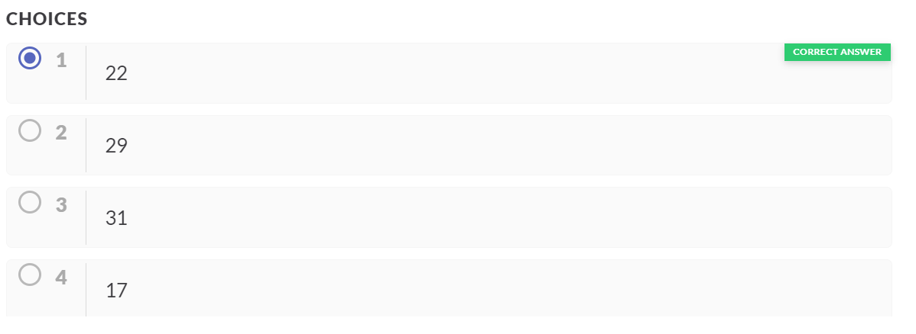
EDA Question 3
DESCRIPTION
For the variable 'Population', count the missing values and find out what percentage is that of total values.

Slide 5
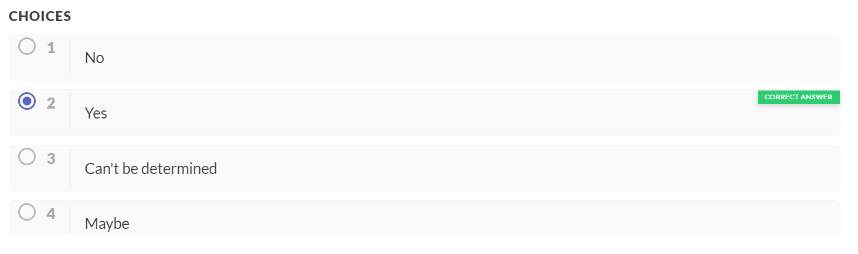
EDA Question 4
DESCRIPTION
Are there any outliers present in the government's total expenditure on health?State Yes/No whether there is a presence of outliers.

Slide 6
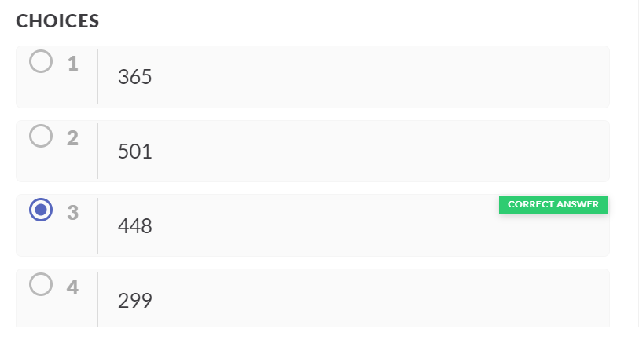
EDA Question 5
DESCRIPTION
How many null values are present in GDP variable

Slide 7
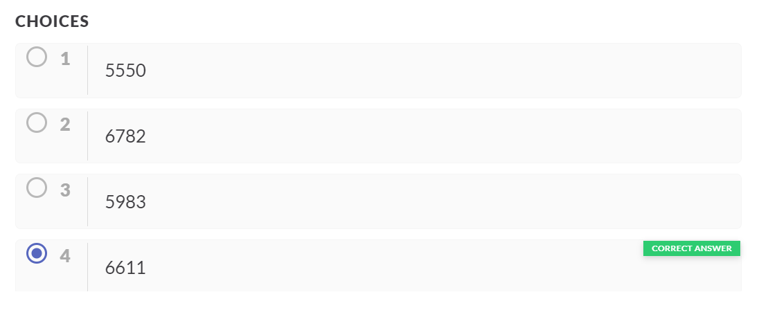
EDA Question 6
DESCRIPTION
Impute the missing values of GDP with median. Calculate the mean after imputing with median.

Slide 8
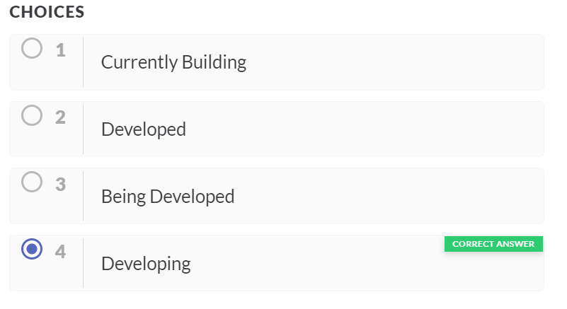
EDA Question 7
DESCRIPTION
State which class in Status variable has the highest frequency?

Slide 9
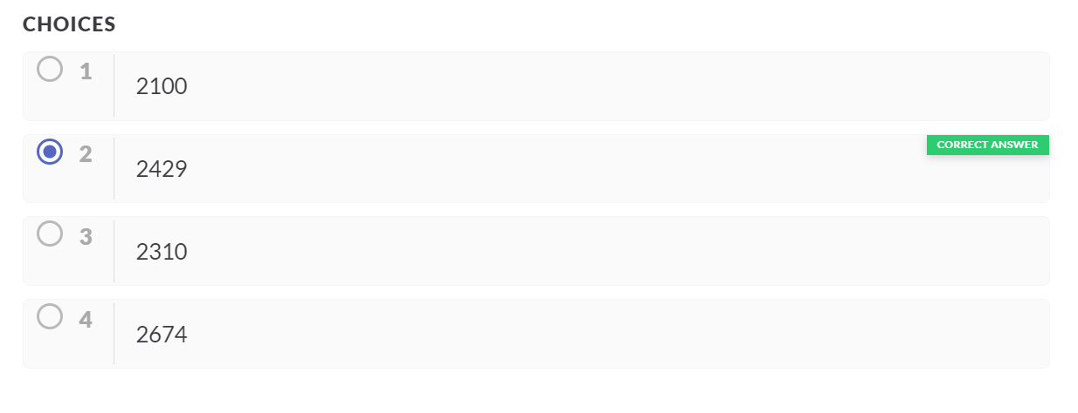
EDA Question 8
DESCRIPTION
Impute the status column with 'Developing' values. Then report the frequency of the 'Developing' category.

Slide 10
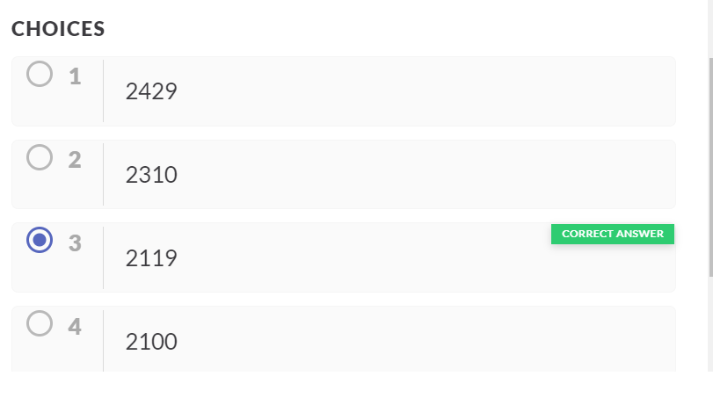
EDA Question 9
DESCRIPTION
State Albania's average GDP.

Slide 11
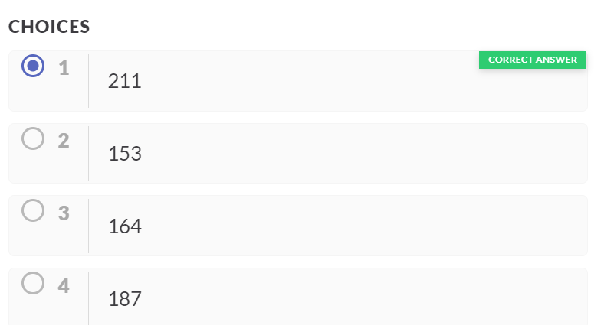
EDA Question 10
DESCRIPTION
State the average adult mortality of Yemen?

Slide 12
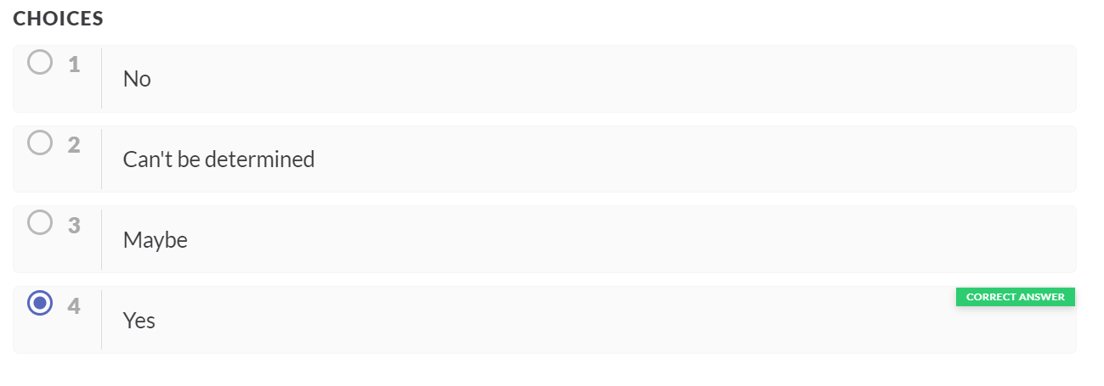
EDA Question 11
DESCRIPTION
Find out using scatter plot is there any linear relation between Percentage expenditure and GDP ?State Yes if true

Slide 13
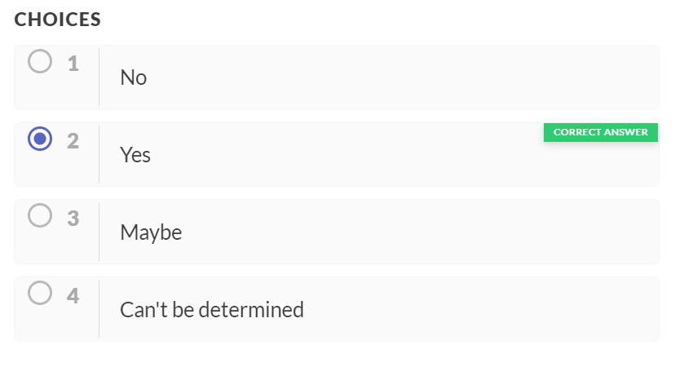
EDA Question 12
DESCRIPTION
Is the adult mortality rate higher in Developing or Developed countries?

